Slide 1
Chapter 8.1 and 8.2
- Chemical Bonds, Lewis Symbols, and the Octet Rule
- Ionic Bonding

Slide 2
Problem Set
Chapter 8:
2, 3, 4, 10, 12, 14, 16, 18, 20, 21

Slide 3
Chapter 8.1 - Chemical Bonds, Lewis Symbols, and the Octet Rule
How are chemical bonds formed?

Slide 4
8.1 Chemical Bonds
Chemical bonds - formed by the transfer or sharing of electrons
Also accompanied by a change in energy
If a bond is favorable, then typically energy will be given off in process
We will study 3 types of intramolecular attraction
***Disclaimer***
all bonding is related to electrons - covalent and ionic bonding are the extremes, but there is a spectrum of bonding types

Slide 5
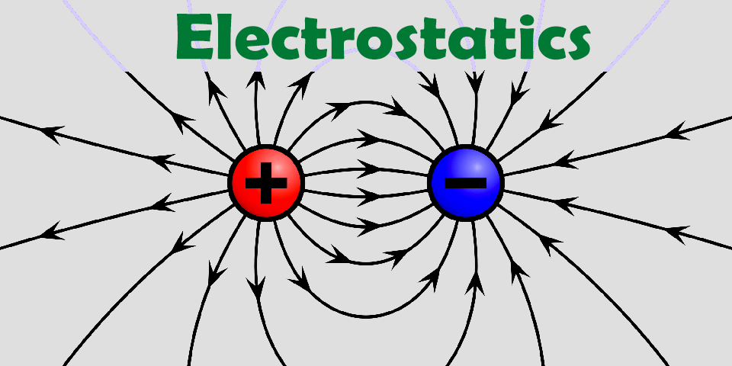
8.1 Types of Chemical Bonds
Ionic - formed through electrostatic attraction forces that exist between ions of opposite charge
For now, we can describe ionic bonds as the bonds between metals and nonmetals
Cations/Anions
Larger the charge difference stronger the bond

Slide 6
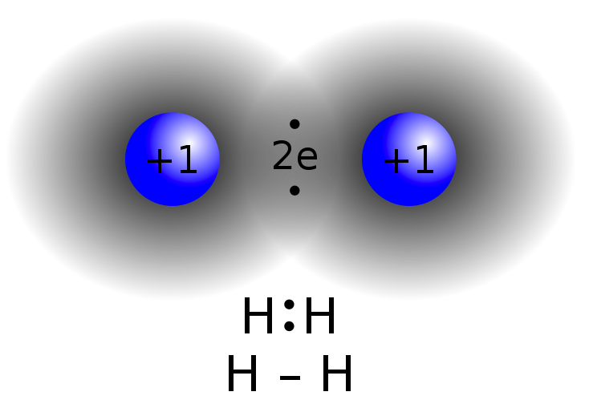
8.1 Types of Chemical Bonds
Covalent - results from the sharing of electrons between two atoms
For now we can describe covalent bonding as the bonding between non metallic elements
Most of this chapter will revolve around the study of covalent bonding

Slide 7
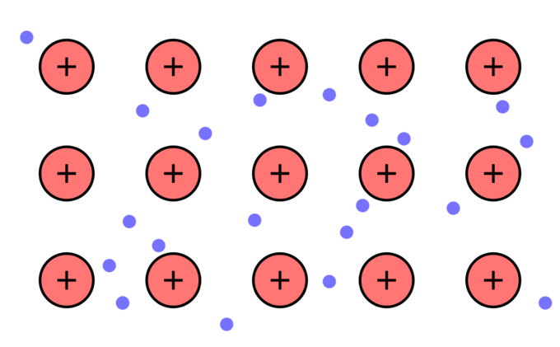
8.1 Types of Chemical Bonds
Metallic - found in metals (surprise) such as copper, iron, and aluminum
Copper atoms are not just floating around freely (obviously), but it is still pure therefore…
There must be some sort bonding present
Each metal atom is bonded to several other atoms around it
Metallic bonds are the reason for properties like conductivity and luster like we discussed in chapter 7
“Sea” of Electrons

Slide 8
8.1 Lewis Symbols
Valence electrons - for most atoms, the electrons residing in the outermost occupied shell of an atom
Lewis symbols - pioneered G.N. Lewis (1875-1946)
also called lewis dot diagrams (lewis structures when combined with other elements)
simple way of showing the valence electrons in an atom
each dot represents a valence electron
most applicable to non metals and covalent structure

Slide 9
8.1 Lewis Dot Diagrams
Example:
Carbon: [He] 2s2, 2p2
Carbon has 4 valence electrons
Dots are placed around the element one at a time
Each side can accommodate 2 electrons
Placement of the lone electrons is arbitrary!!
Lewis symbol for Carbon

Slide 10
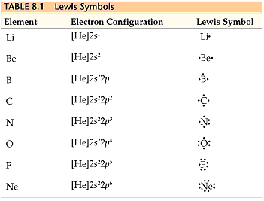
8.1 Lewis Symbols for Row 2

Slide 11
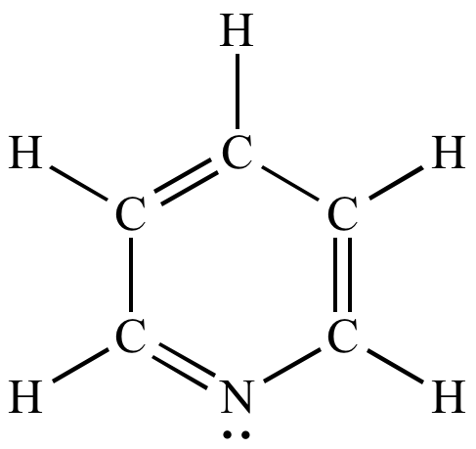
8.1 Octet Rule
Octet Rule - atoms tend to gain, lose, or share electrons until they are surrounded by 8 valence electrons
There are many exceptions to the the octet rule but…
It is a very useful introductory concept to discuss chemical bonding
Despite the exceptions it applies to a large degree of bonding principles
Application to Lewis Structures,
no exceptions

Slide 12
8.2 Ionic Bonding
A classic example of ionic bonding is the formation of salt of NaCl
Na (s) + 1/2 Cl2 (g) —> NaCl (s) ΔHf= -410.9 kJ
In this example, we can imagine, sodium transferring its electron to chlorine, forming a stable ionic bond
This reaction is highly exothermic, and favorable due to the fact that it releases energy
Ionic substances are typically found between elements with low ionization energy and high electron affinity.
Lonnie's Labs

Slide 13
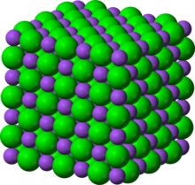
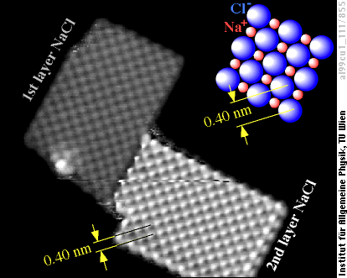
8.2 Lattice Energy
Lattice energy - energy required to completely separate a mole a solid ionic compound into its gaseous atoms
Strength of an ionic solid is given by the lattice energy
Energy needed to break the bonds in the crystal, return the atoms to gaseous state
NaCl (s) →Na⁺ (g) + Cl⁻ (g)
ΔHlattice= + 788 kJ/mol
NaCl Lattice

Slide 14
8.2 Born - Haber Cycle
Useful application of Hess’s law
Theoretical calculation of the lattices energy of NaCl by way for first ionization energies, and electron affinity calculation
Very difficult to measure lattice energy directly

Slide 15
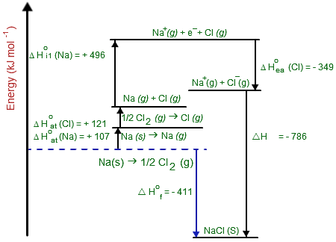
Born Haber Cycle (indirect measurement of lattice energy)

Slide 16
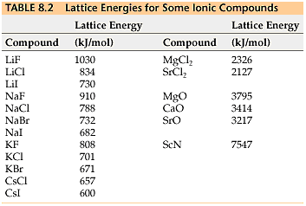
8.2 Lattice Energy Trend

Slide 17
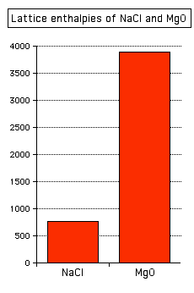
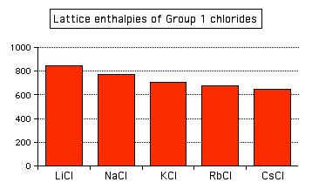
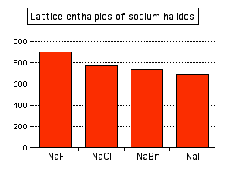
8.2 Affects on lattice
Larger charge difference - greater strength (Coulombs law)
Bigger effect in this trend
Larger atoms - less strength (Coulombs law)

Slide 18
8.2 Predicting Ions
Determining an ions likely charge is taken from the table and..
Its electron configuration
Na: [Ne] 3s1
Na +
Predict the charges of the following
S, Sr, Al

Slide 19
8.2 Transition Metal Ions
Although most metal ions are +1 or +2,
Many transition metal ions have more electrons than simply 1 or 2 electrons past a noble gas core (clear exception to octet rule)
Remember for chapter 7, elements lose electrons with highest principal quantum number first
4s before 3d
Fe : [Ar] 3d6 4s2
Fe 2+ : [Ar] 3d6
Fe 3+ : [Ar] 3d5

Slide 20
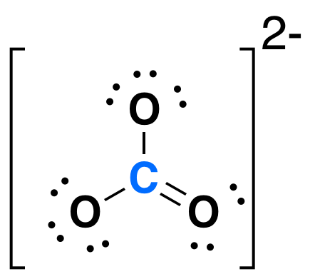
8.2 Polyatomic Ions
Common cations and anions that display both ionic and covalent characteristics
Predominantly bound by negative bonds
Form a stable group that carries either a positive or negative charge

Slide 21
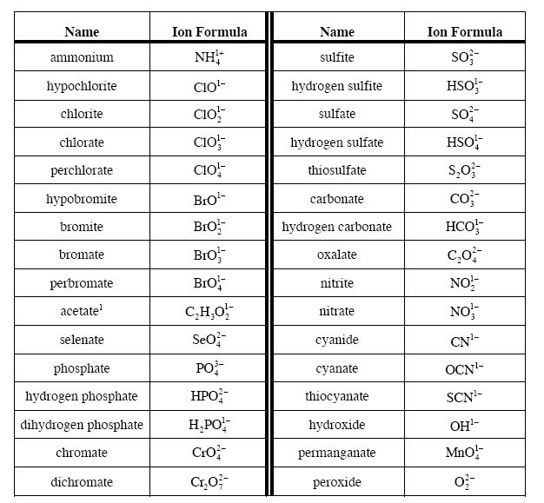
8.2 Common Polyatomic Ions

